Slide 1

Academic Year 2024 - 25 S6 MINI PROJECT - II Second Review
PROJECT TITLE
BUS RESERVATION SYSTEM
BIP PROJECT ID
26S6MIN401
CATEGORY
INTERNAL
BATCH MEMBERS
SURYA PRAKASH R (7376222AL214)
LOGESHRAJA M(7376232AL505)
SURENTHIRAN S (7376221ME149)
GUIDE
DR.PRAKASH K B
Assistant Professor Level III
Department of Mechanical Engineering

Slide 2
AIM & OBJECTIVES OF THE PROJECT (Problem Statement)
AIM:
To develop a user-friendly Bus Reservation System that streamlines the ticket purchasing process, enhances customer experience, and improves operational efficiency for bus service providers.
OBJECTIVE:
Enable secure user accounts for easy booking and management.
Provide up-to-date information on bus schedules and seat availability.
Facilitate secure online payment options for seamless transactions.
Allow users to view, modify, or cancel their bookings conveniently.

Slide 3
LITERATURE SURVEY
Sl.No. | References ( Journal Papers Only) | Works carried out ( with details of Methods/ Materials/ Software/ Algorithms / fabrication / techniques/ components used ) | Information gathered relevant to your project
1 | ""A Framework for Secure Online Bus Ticket Booking System" by Sharma, P., & Gupta, R. (2020) | Developed a secure framework using encryption techniques for transaction safety. Integrated APIs for route management and real-time seat availability. | Highlights security aspects and real-time data updates crucial for user trust and system reliability.
2 | "Design and Implementation of a Scalable Online Bus Reservation System" by Lee, M., & Kim, J. (2019) | Used a microservices architecture to scale user requests efficiently, with cloud storage integration for handling peak loads. | Provides insight into handling large-scale user traffic and ensuring system availability during high demand.
3 | "User Experience in Online Bus Ticket Systems" by Hassan, N., & Kaur, S. (2021) | Focused on UI/UX improvements using user behavior analysis and feedback loops, implemented with React for a responsive design. | Shows the importance of user-friendly interfaces to increase booking efficiency and customer satisfaction.
4 | "Machine Learning for Price Prediction in Bus Ticket Systems" by Zhang, H., & Li, F. (2022) | Used machine learning models (Random Forest, SVM) to dynamically predict ticket prices based on demand, time, and availability. | Demonstrates how dynamic pricing can optimize seat utilization and revenue.
5 | "Blockchain-Based Online Bus Ticketing System for Transparency" by Patel, A., & Singh, L. (2023) | Implemented blockchain for ticketing transactions, ensuring transparent and tamper-proof booking records. | Highlights the role of blockchain in enhancing data integrity and transaction transparency.

Slide 4
LITERATURE SURVEY
Sl.No. | References ( Journal Papers Only) | Works carried out ( with details of Methods/ Materials/ Software/ Algorithms / fabrication / techniques/ components used ) | Information gathered relevant to your project
6 | "Mobile-Friendly Bus Reservation System" by Kumar, A., & Desai, P. (2021) | Developed a cross-platform mobile app using Flutter to support Android and iOS users, ensuring mobile responsiveness and offline booking features. | Highlights the need for mobile-first design, essential for modern users who prefer booking via smartphones.
7 | "Optimizing Seat Allocation in Bus Ticketing Systems" by Tan, W., & Zhang, R. (2020) | Applied a heuristic algorithm to optimize seat allocation and minimize unoccupied seats by considering passenger preferences and travel history. | Demonstrates how intelligent seat allocation can increase occupancy rates and improve user experience.
8 | "Real-Time Bus Schedule Tracking and Integration with Ticket Booking System" by George, M., & Thomas, J. (2019) | Integrated GPS-based real-time bus tracking with the booking system using REST APIs for live bus schedule updates and delay predictions. | Highlights the benefit of real-time bus tracking integration for better user convenience and system accuracy.
9 | "Big Data Analytics in Bus Ticketing Systems" by Silva, D., & Almeida, P. (2022) | Leveraged big data analytics tools (Hadoop, Spark) to analyze customer booking patterns, optimize routes, and predict peak times for ticket sales. | Shows the value of data-driven decisions in optimizing route planning and improving customer service.
10 | "Multi-Language Support in Bus Ticket Booking Systems" by Hernandez, S., & Garcia, R. (2020) | Implemented multi-language support using Natural Language Processing (NLP) tools for a global user base, enhancing accessibility. | Highlights the importance of localization and language support for wider user reach and inclusivity..

Slide 5
SCOPE OF THE PROJECT
Development of a user-friendly and responsive interface for easy navigation and booking on desktop devices.
Implementation of secure user registration, login, and profile management features, allowing customers to track and manage their bookings.
Integration with various bus operators to provide accurate real-time information on bus schedules, seat availability, and pricing.
Incorporation of secure payment gateways to facilitate diverse payment options, ensuring safe and seamless transactions.
Inclusion of support mechanisms such as live chat and FAQs, enabling users to get assistance and resolve issues quickly throughout their booking journey.

Slide 6
NEED FOR THE CURRENT STUDY
Users require a seamless booking experience that allows them to purchase tickets anytime and anywhere, reducing reliance on physical ticket counters.
Traditional booking methods often involve long wait times; an online system speeds up the process, allowing users to book in minutes.
Customers need accurate, real-time information on bus schedules and seat availability to make informed decisions.
A user-friendly platform improves overall satisfaction, encouraging repeat usage and loyalty.
Bus operators benefit from automated processes, reducing administrative tasks and increasing sales through broader market reach.

Slide 7
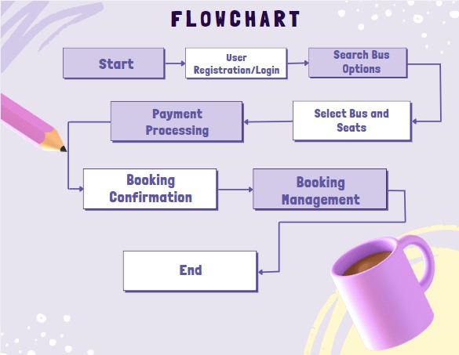
PROPOSED METHODOLOGY ( Flow Chart)

Slide 8
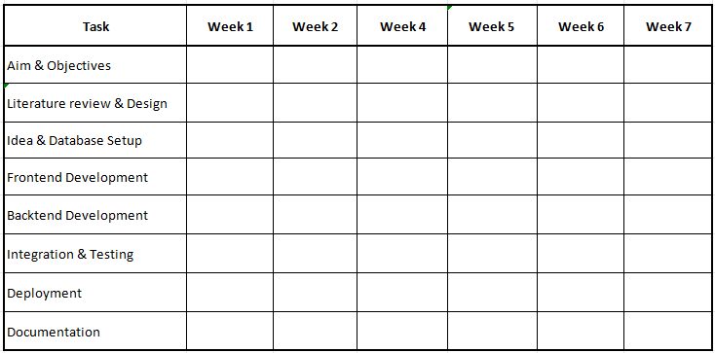
PROPOSED METHODOLOGY ( Gantt Chart)

Slide 9
CHOICE OF COMPONENTS / MODULES / METHODS/TECHNIQUES EQUIPMENT USED FOR PROJECT DEVELOPMENT
COMPONENTS:
Visual studio code
GitHub
METHODS:
Implemented to promote iterative development and continuous feedback. This approach allows for regular updates and adjustments based on user needs and stakeholder input, ensuring the system evolves effectively throughout the development process.
Utilized to create a clear and standardized communication protocol between the frontend and backend. This method enables seamless interaction between components, allowing for efficient data exchange and manipulation while maintaining a scalable architecture.

Slide 10
DESIGN(S) (HARDWARE / SOFTWARE ARCHITECTURE)
The system follows a client-server model where the frontend (client) interacts with the backend server to perform operations like booking, searching, and payment.
The frontend is built using HTML, CSS, and JavaScript to create user-friendly pages for login, seat selection, and booking, accessible via a web browser.
The backend is developed using Flask or Django, managing routing, session handling, and implementing the business logic for reservation and admin functions.
Securely processes payments via third-party services like PayPal or local payment processors. Handles encryption, transaction confirmation, and validation.
An admin panel for bus management and user monitoring is included. Security is ensured through password hashing, user authentication, and secure payment gateway integration.

Slide 11
INDIVIDUAL CONTRIBUTIONS TO THE WORK
Batch Member 1 : (7376222AL214 – SURYA PRAKASH R)
Django:
I contributed to the development of a Django-based Bus Reservation System by working on essential modules such as views.py, models.py, and forms.py. I implemented the logic for user authentication, seat booking, and bus search functionalities. I also designed and connected database models, handled form validations, and configured routing in urls.py. Additionally, I supported the creation of reusable components, managed admin controls in admin.py, and ensured smooth system operations through testing and configuration of project settings in settings.py.

Slide 12
INDIVIDUAL CONTRIBUTIONS TO THE WORK
Batch Member 2 : (7376232AL505 – LOGESHRAJA M)
Frontend:
I contributed to the frontend of the Bus Reservation System by designing and developing responsive HTML pages for user signup, login, bus search, seat selection, and booking confirmation. I used structured HTML5 elements to ensure semantic clarity and accessibility. Each page was integrated with backend views for dynamic data display. I also created clean and user-friendly layouts, aligning with modern web design practices. My HTML work played a key role in providing intuitive navigation and seamless user experience across the platform.

Slide 13
INDIVIDUAL CONTRIBUTIONS TO THE WORK
Batch Member 3 : (7376221ME149 - SURENTHIRAN S)
Database:
I contributed to the UI/UX design of the Bus Reservation System using Figma by creating interactive wireframes and high-fidelity prototypes for key pages such as login, bus search, seat selection, and booking confirmation. I focused on user flow, layout structure, visual hierarchy, and responsiveness. Components and styles were designed consistently for reusability. I also collaborated with the development team by sharing design specs and assets, ensuring smooth implementation of the Figma prototypes into the actual frontend application.

Slide 14
Status on Partial Completion and Submission of Project Report
List of Documents to be Submitted
SL.No | List of Documents | Status ( Provide the drive link of prepared document)
1 | Cover Page & Title Page (Both are in same format) | https://docs.google.com/document/d/1--lZ-vVMWIjvNcNimxYd2jlLn8yo_gQpLuL_SudZl8M/edit?usp=sharing
2 | Bonafide Certificate | https://docs.google.com/document/d/1BGag1i8ffYDWO207HPobU5eHiDi9lrZ4o60X6nDkQnM/edit?usp=sharing
3 | Declaration | https://docs.google.com/document/d/1ZPSTQPQ86HvvCtJAhaPAdZa4Bz1QUk9XBm53U34xlG8/edit?usp=sharing
4 | Acknowledgement | https://docs.google.com/document/d/1eH539EG4mcRzmoEmCQzsAXOzzd0ELIDmGbNW75PxiZw/edit?usp=sharing
5 | Chapter I – Introduction | https://drive.google.com/file/d/1_Hzr9sczd-riKnhiAl0_0N0phZqXhyNM/view?usp=sharing
6 | Chapter 2 – Literature Survey | https://drive.google.com/file/d/1T-kuB3iLZNqTTlPDRvG4vjNPTMKj3_vL/view?usp=sharing

Slide 15
Submission of Project Report
List of Documents to be Submitted
SL.No | List of Documents | Status ( Provide the drive link of prepared document)
7 | Chapters 3 - Objectives and Methodology | https://drive.google.com/file/d/1xD1EaaGDGHawb1ND1YAnMq-W7yXaotoV/view?usp=sharing
8 | Chapters 4 - Proposed work modules (Chapters name can be based on the work) | https://drive.google.com/file/d/1mK0RqgjjTiLIWB7SUcU5EFy5t2x7Fsaj/view?usp=sharing
9 | Chapter 5 - Results and Discussion | https://drive.google.com/file/d/1mK0RqgjjTiLIWB7SUcU5EFy5t2x7Fsaj/view?usp=sharing
10 | Chapters 6 - Conclusions & Suggestions for Future work | https://drive.google.com/file/d/18YyiG87zAGGTDbISrZJb3xwDSg7v5wjf/view?usp=drive_link
11 | References | https://drive.google.com/file/d/18YyiG87zAGGTDbISrZJb3xwDSg7v5wjf/view?usp=drive_link
12 | Appendices | https://drive.google.com/file/d/1UDSAhdMYvpQBcpWTX_PhzeQMmn1I7We0/view?usp=drive_link
SECOND REVIEW PRESENTATION
11-04-2025

Slide 16
REFERENCES ( Journal Papers/ Books / Website in IEEE Format )
Journal
[1]. S. Kumar, P. Gupta, and R. Sharma, "Design and Implementation of an Online Bus Ticket Reservation System Using Web Technologies," International Journal of Computer Applications, vol. 180, no. 30, pp. 45-50, March Books
[1]. M. A. Hossain, Online Bus Ticket Booking System: Design, Development, and Implementation, New Delhi, India: Pearson, 2018.
[2]. J. R. Patel, E-Ticketing System for Public Transport: A Comprehensive Guide, Oxford, UK: Oxford University Press, 2017.
Patent
[1]. J. Williams and A. Carter, "Bus Reservation System," U.S. Patent US10284756B2, April 30, 2019.
Website
[1]. MakeMyTrip, "Online Bus Ticket Booking: Compare, Book & Save," makemytrip.com. https://www.makemytrip.com/bus-tickets/

